Slide 1
Prediction Algorithm for Weekly Asthma Admissions
Presented By:
Stephen Colegate, Ph.D.
Postdoctoral Research Fellow
stephen.Colegate@cchmc.org

Slide 2
Data Description
Daily number of patients admitted with asthma.
Timespan: January 1, 2016 – June 30, 2023.
Includes admissions from:
All
Avondale
City of Cincinnati
Hamilton County
Eight Catchment Area
Overlap is present between these areas.

Slide 3
Data Description

Slide 4
Data Description
Day | Year | MONTH_NUMBER | MONTH_NAME | MonthDate | AllAdmissions | AvondaleAdmissions | CinciAdmissions | HamiltonCountyAdmissions | EightCatchmentAdmissions
1/1/2016 | 2016 | 1 | January | 1/1/2016 | 3 | 0 | 2 | 2 | 2
1/2/2016 | 2016 | 1 | January | 1/1/2016 | 6 | 0 | 2 | 2 | 6
1/3/2016 | 2016 | 1 | January | 1/1/2016 | 0 | 0 | 0 | 0 | 0
1/4/2016 | 2016 | 1 | January | 1/1/2016 | 2 | 0 | 1 | 0 | 2
1/5/2016 | 2016 | 1 | January | 1/1/2016 | 0 | 0 | 0 | 0 | 0
1/6/2016 | 2016 | 1 | January | 1/1/2016 | 1 | 0 | 1 | 1 | 1
1/7/2016 | 2016 | 1 | January | 1/1/2016 | 0 | 0 | 0 | 0 | 0
1/8/2016 | 2016 | 1 | January | 1/1/2016 | 1 | 0 | 1 | 1 | 1
1/9/2016 | 2016 | 1 | January | 1/1/2016 | 0 | 0 | 0 | 0 | 0
1/10/2016 | 2016 | 1 | January | 1/1/2016 | 2 | 0 | 1 | 1 | 1
1/11/2016 | 2016 | 1 | January | 1/1/2016 | 1 | 0 | 1 | 1 | 1
1/12/2016 | 2016 | 1 | January | 1/1/2016 | 1 | 0 | 1 | 1 | 1
1/13/2016 | 2016 | 1 | January | 1/1/2016 | 3 | 0 | 2 | 2 | 3
1/14/2016 | 2016 | 1 | January | 1/1/2016 | 0 | 0 | 0 | 0 | 0
Focus on the All Admissions column.
Treat # cases weekly.

Slide 5
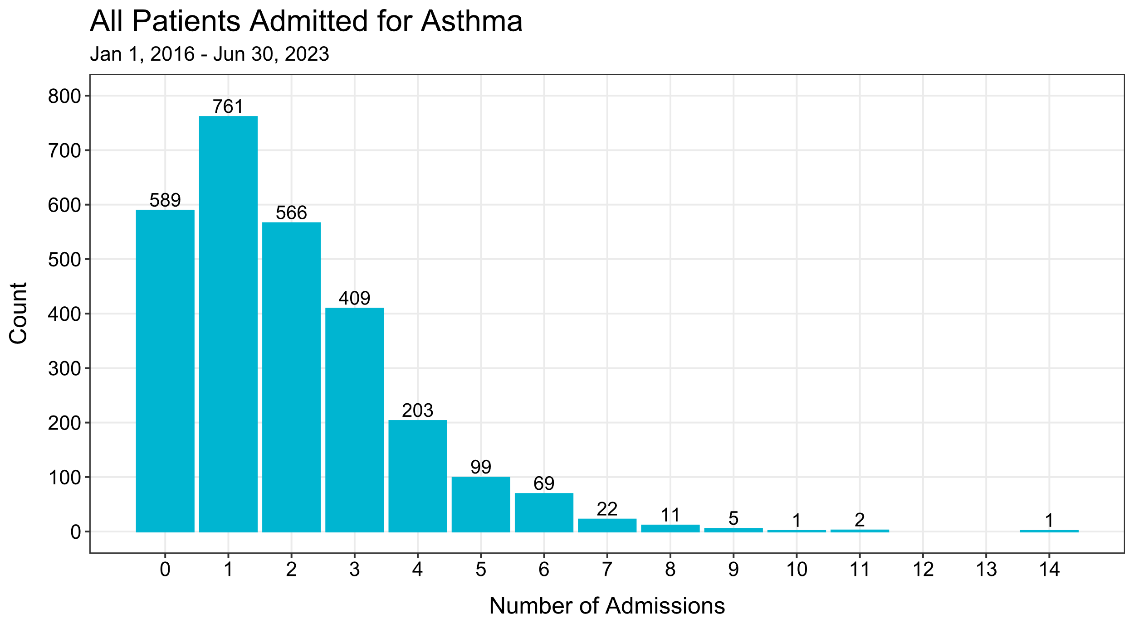

Slide 6
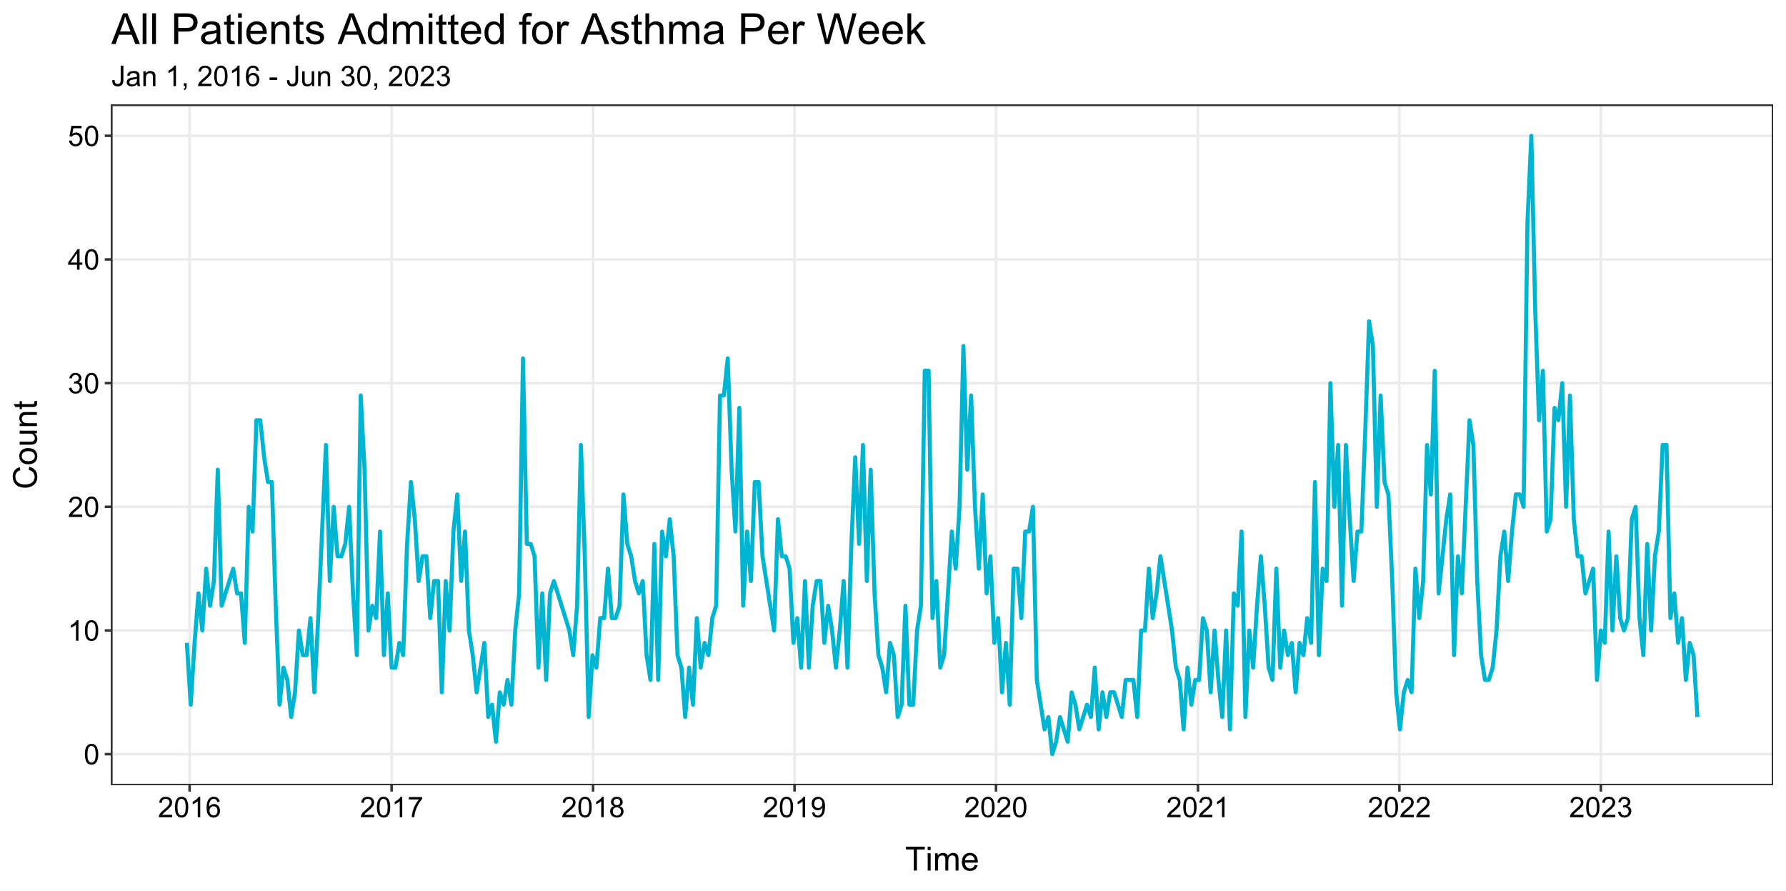

Slide 7
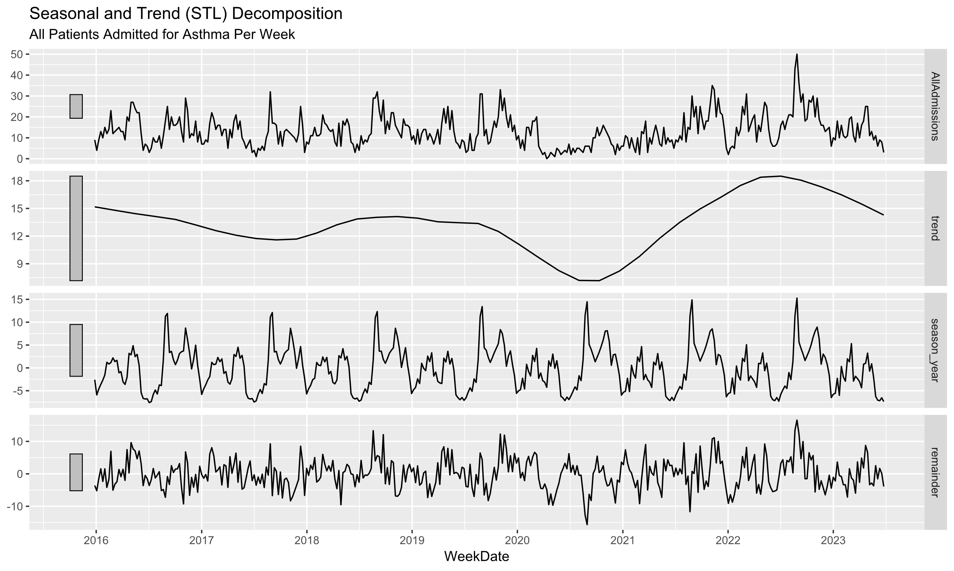

Slide 8
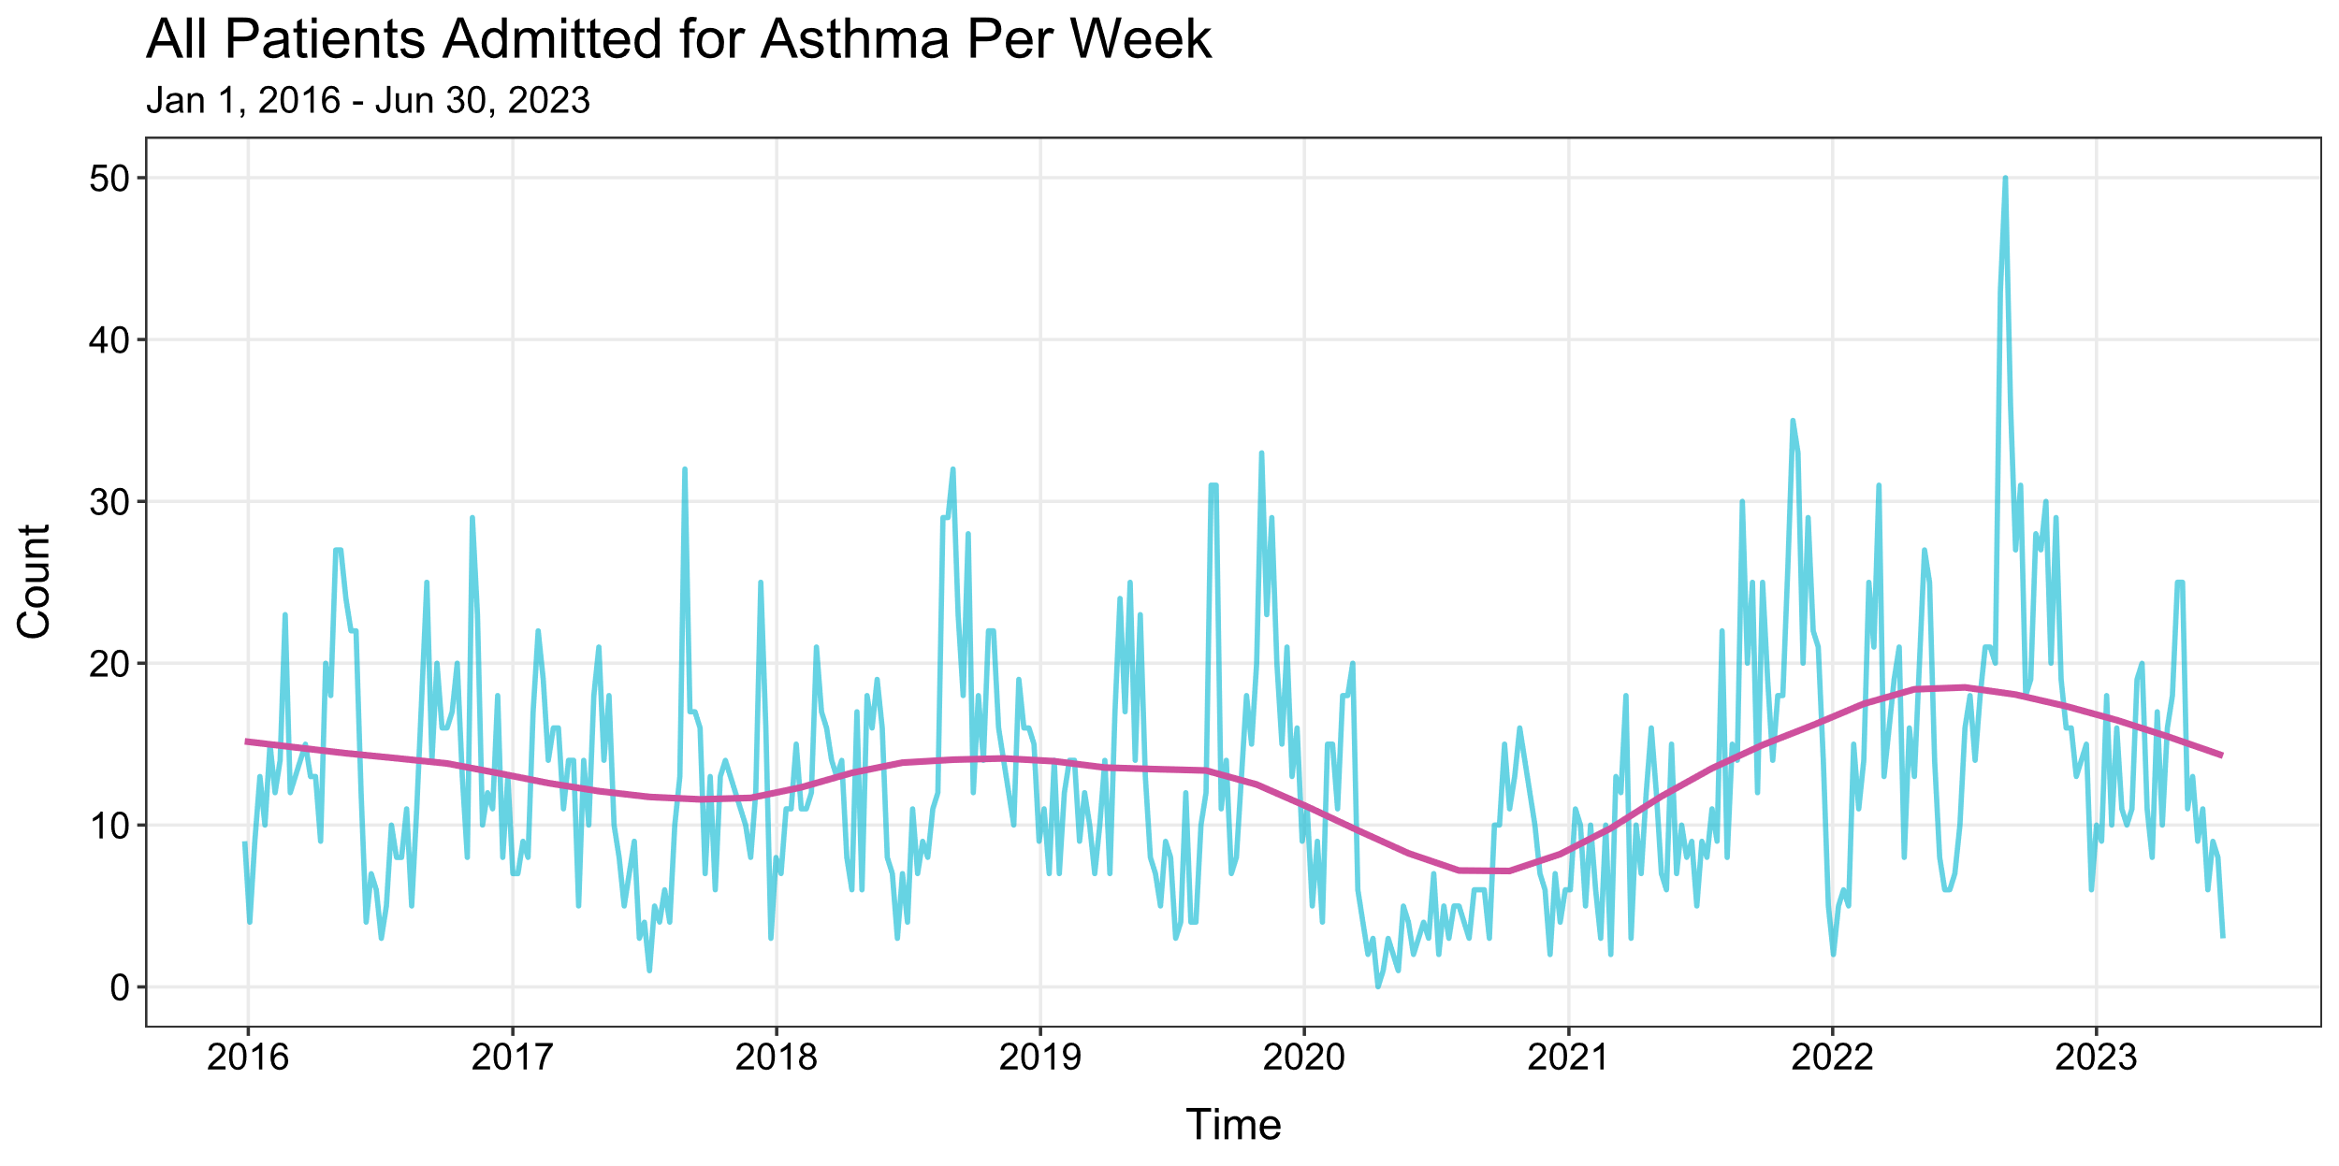

Slide 9
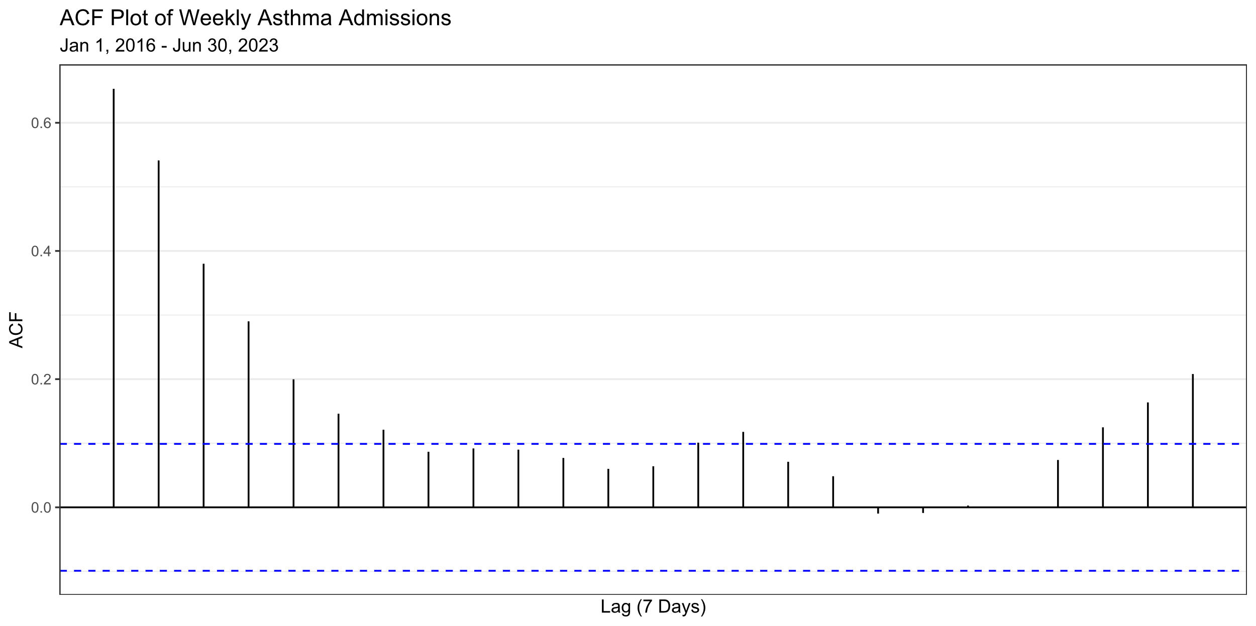

Slide 10
Data Exploration
Noticeable drop - Spring 2020.
No signs of trend.
No signs of seasonality.
One unusual high week
August 28 – September 3, 2022: 50
One unusual low week
April 12 – 19, 2020: 0
Weeks are strongly autocorrelated.

Slide 11
Model Predictions

Slide 12
Model Predictions
ts_fit.R: Custom function to make future predictions based on training (observed) data.
Options:
ts_train: Training set with WeekDate (first date of week) and AllAdmissions (observed asthma admissions).
ts_test: Test set with WeekDate and AllAdmissions columns to make predictions.
lookahead: Number of weeks to make predictions.
level: Confidence level for each prediction.
ts_keep: Whether to include training data with predictions.
Default – Don’t include (FALSE).

Slide 13
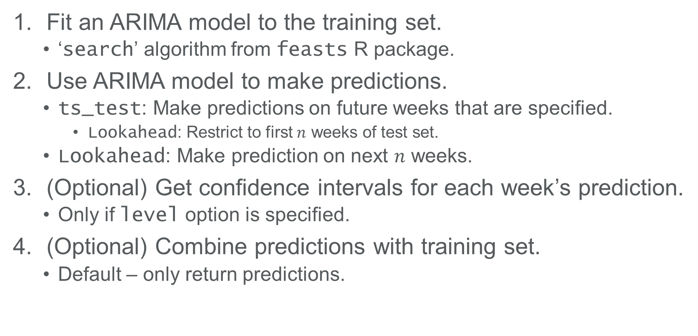
Model Predictions
Fit an ARIMA model to the training set.
‘search’ algorithm from feasts R package.
Use ARIMA model to make predictions.
ts_test: Make predictions on future weeks that are specified.
Lookahead: Restrict to first $n$ weeks of test set.
Lookahead: Make prediction on next $n$ weeks.
(Optional) Get confidence intervals for each week’s prediction.
Only if level option is specified.
(Optional) Combine predictions with training set.
Default – only return predictions.

Slide 14
Example
Goal: Predict future weekly all asthma admissions.
Training set: January 1, 2016 – December 31, 2021.
Test set: January 1, 2022 – March 31, 2022.
Use ts_fit.R function to make predictions:
Fit a model to the training set.
Use the model to make predictions on the test set.
Compare model predictions to observed admissions to evaluate model performance.

Slide 15
Example
WeekDate | AllAdmissions
2016-01-03 | 4
2016-01-10 | 9
2016-01-17 | 13
2016-01-24 | 10
2016-01-31 | 15
2016-02-07 | 12
2016-02-14 | 14
2016-02-21 | 23
:
2022-02-20 | 25
2022-02-27 | 21
2022-03-06 | 31
2022-03-13 | 13
2022-03-20 | 16
2022-03-27 | 19
Training set:
Weekly asthma admissions.
All admissions.
Start: January 1, 2016.
End: March 31, 2022.
326 weekly observations.

Slide 16
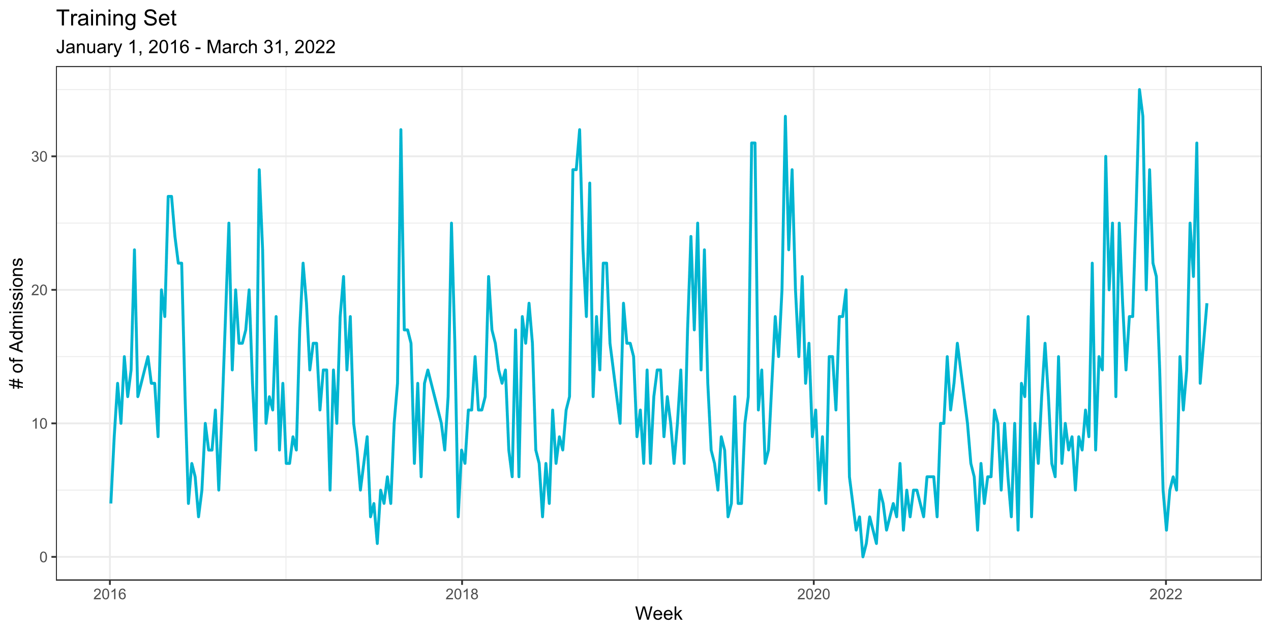
Example

Slide 17
Example
WeekDate | AllAdmissions
2022-04-03 | 21
2022-04-10 | 8
2022-04-17 | 16
2022-04-24 | 13
2022-05-01 | 20
2022-05-08 | 27
2022-05-15 | 25
2022-05-22 | 14
2022-05-29 | 8
2022-06-05 | 6
2022-06-12 | 6
2022-06-19 | 7
2022-06-26 | 10
Test set:
Weekly asthma admissions.
All admissions.
Start: April 1, 2022.
End: June 30, 2022.
13 weekly observations.

Slide 18
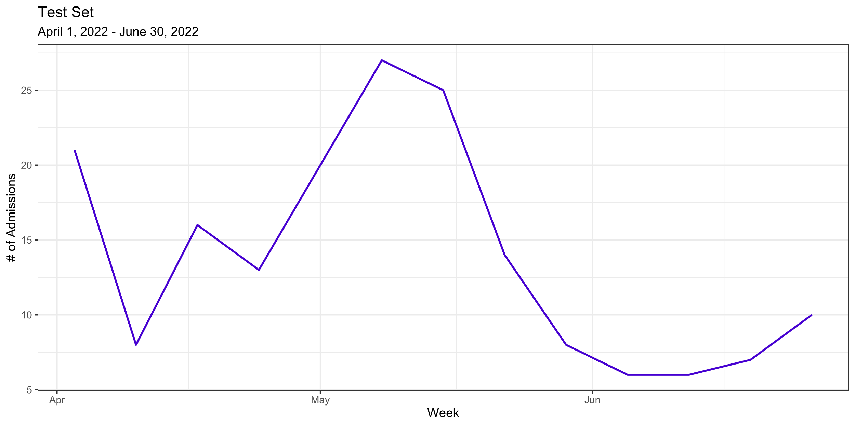
Example

Slide 19
Example
WeekDate | AllAdmissions | Predict
2022-04-03 | 21 | 15.7
2022-04-10 | 8 | 15.6
2022-04-17 | 16 | 14.6
2022-04-24 | 13 | 13.9
2022-05-01 | 20 | 13.5
2022-05-08 | 27 | 13.1
2022-05-15 | 25 | 12.9
2022-05-22 | 14 | 12.8
2022-05-29 | 8 | 12.7
2022-06-05 | 6 | 12.6
2022-06-12 | 6 | 12.6
2022-06-19 | 7 | 12.5
2022-06-26 | 10 | 12.5
Evaluation:
Prediction balances mean of time series and the most recent observation(s).
Predictions converge to mean of time series further out in time.
Model only useful to predict one or two weeks at most.

Slide 20
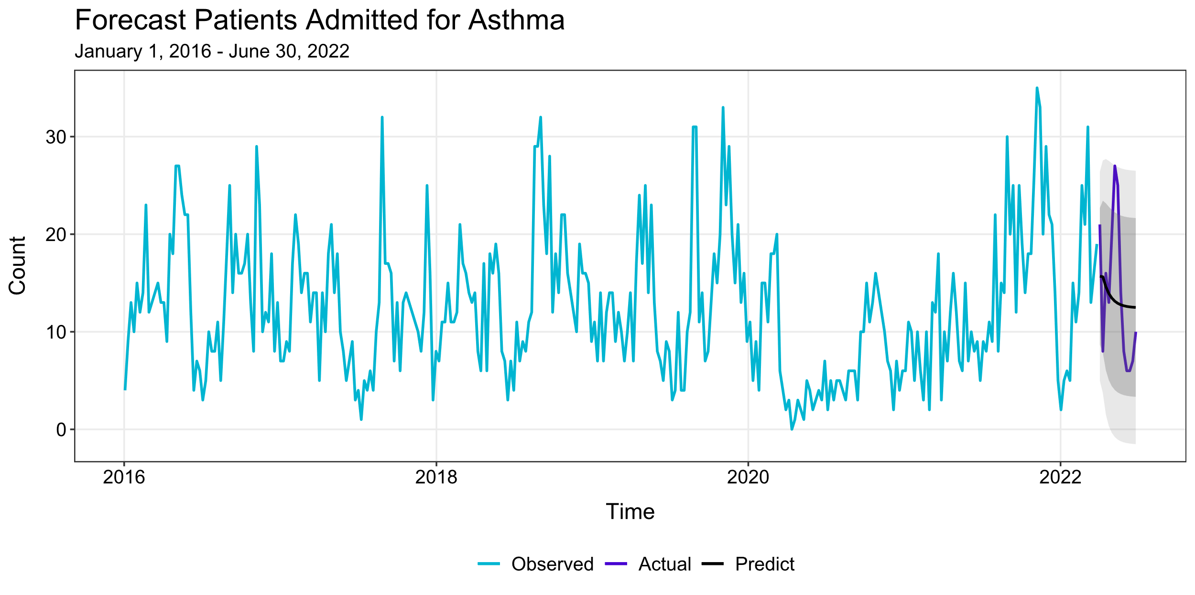
Example

Slide 21
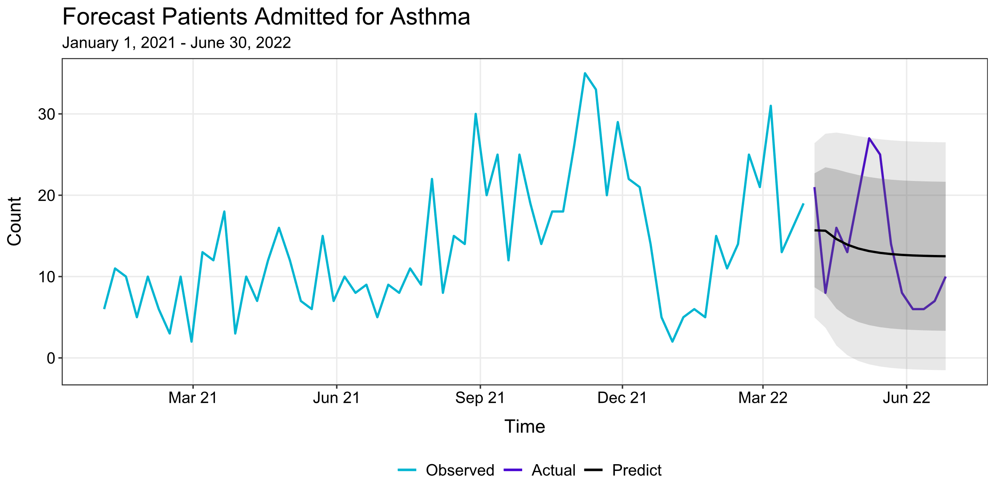
Example

Slide 22
Model Predictions
Advantages:
Easy to use and implement.
Different class of models can be considered.
ARIMA, ETS, BATS, NN.
ts_fit.R is a template that can be customized.
Ability to fit dynamic models.
Include other variables (e.g., AQI) to assist model predictions.
ts_fit.R can be adapted to other time series projects.
Employee injury data.
Function can be expanded on to fit one’s needs.
Confidence intervals, residuals, etc.

Slide 23
Model Predictions
Disadvantages:
Predictions only good in the near-term.
Not adequate for long-range forecasts.
Does not include seasonality or differencing well.
Requires lots of data to utilize.
Incorporating seasonality and/or differencing may not improve predictions.
Can be cumbersome to customize.
E.g., changing variable names.
No sense of model prediction accuracy.
Need an evaluation procedure to evaluate model predictions.

Slide 24
Rolling Predictions

Slide 25
Rolling Predictions
How ts_fit.R would be deployed in practice:
We have historical weekly asthma admissions data.
Clinician provides weekly asthma admissions for the week.
Fit a model with historical data + new data.
Use the model to make forecast for next week.
Compare actual observed admissions to prediction.
ts_fit.R fits model and predicts next week’s admissions.
Steps 1-4.
How does ts_fit.R model work if model is updated each week with new prediction numbers?
25

Slide 26
Rolling Predictions
Rolling prediction – prediction based on a model that is fitted using most recently available data.
Implementation:
Build training data using historical weekly asthma admissions data.
Fit model using the training data.
Predict next week’s asthma admissions from the model.
Observe the actual weekly asthma admissions number.
Include this newest weekly admissions number to the training data.
Repeat steps 2-5 each week.
Each week, the model is “refitted” to incorporate the newest admissions data before making predictions.

Slide 27
Rolling Predictions
ts_refit.R incorporates refit() from the feasts R package.
Options:
ts_train: Training set with WeekDate (first date of week) and AllAdmissions (observed asthma admissions).
ts_test: Test set with WeekDate and AllAdmissions columns to make predictions.
reestimate: Whether to refit the model each week before making predictions.
Default – Refit (TRUE): Simulates us refitting the model each week.
ts_keep: Whether to include training data with predictions.
Default – Don’t include (FALSE).
ts_refit.R is not the same as ts_fit.R.
ts_fit.R makes predictions from one point in time.
ts_refit.R takes advantage of actual future observations.
Whether model is updated or not – reestiamte.

Slide 28
Rolling Predictions
ts_refit.R illustrates the process of updating the prediction model each week.
Template to evaluate model specified in ts_fit.R.
ts_refit.R does not depend on ts_fit.R.
Based on the most recent admissions data, the model should respond accordingly.
How much weight should be placed on more recent observations?
Evaluate performance by comparing forecast to actual admissions.
How to select criteria to grade predictions?

Slide 29
Example
Goal: Predict future weekly all asthma admissions.
Training set: January 1, 2016 – March 31, 2022.
Test set: April 1, 2022 – September 30, 2022.
Use ts_refit.R function to make rolling predictions:
Fit a model to the training set.
Same model specified in ts_fit.R.
Employs the “rolling predictions” strategy.
Model is refitted based on latest admissions data before making new prediction.
Grade predictions based on future observed admissions.
Forecast HIGH/LOW if prediction is higher/lower than last week’s admissions data.
Determine if HIGH/LOW forecast matches actual observed admissions data.
Reward 1 point for correct forecast.
Reward 0 points for missed forecast.

Slide 30
Example
WeekDate | AllAdmissions
2016-01-03 | 4
2016-01-10 | 9
2016-01-17 | 13
2016-01-24 | 10
2016-01-31 | 15
2016-02-07 | 12
2016-02-14 | 14
2016-02-21 | 23
:
2022-02-20 | 25
2022-02-27 | 21
2022-03-06 | 31
2022-03-13 | 13
2022-03-20 | 16
2022-03-27 | 19
Training set:
Weekly asthma admissions.
All admissions.
Start: January 1, 2016.
End: March 31, 2022.
326 weekly observations.

Slide 31
Example

Slide 32
Example
WeekDate | AllAdmissions
2022-04-03 | 21
2022-04-10 | 8
2022-04-17 | 16
2022-04-24 | 13
2022-05-01 | 20
2022-05-08 | 27
2022-05-15 | 25
2022-05-22 | 14
:
2022-08-21 | 43
2022-08-21 | 50
2022-09-04 | 36
2022-09-11 | 27
2022-09-18 | 31
2022-09-25 | 18
Test set:
Weekly asthma admissions.
All admissions.
Start: April 1, 2022.
End: September 30, 2022.
26 weekly observations.

Slide 33
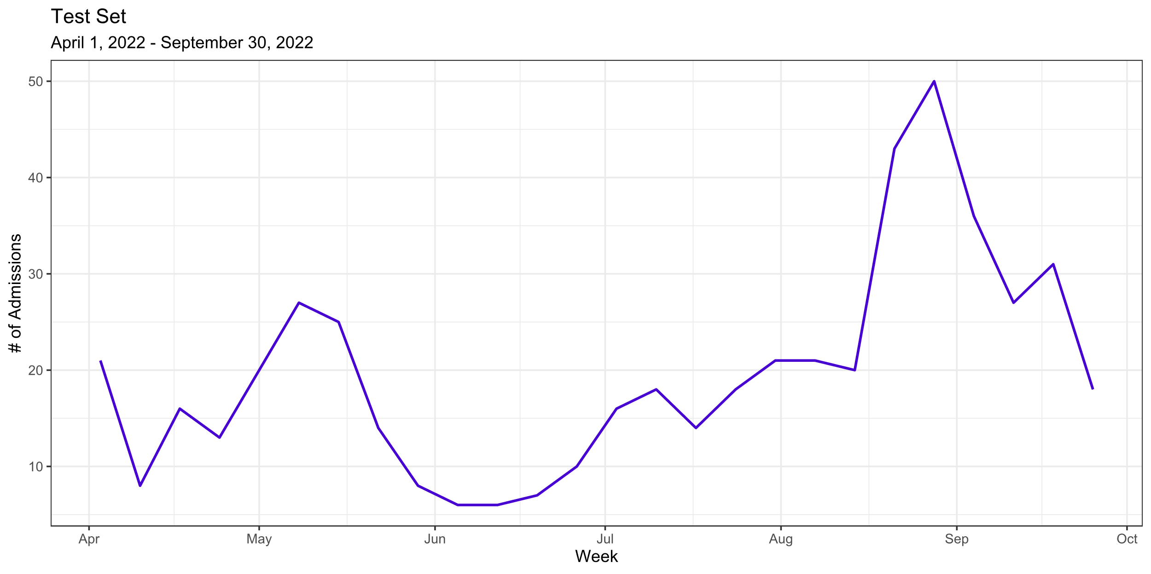
Example

Slide 34
Example
WeekDate | AllAdmissions | Predict
2022-04-03 | 21 | 20.2
2022-04-10 | 8 | 20.1
2022-04-17 | 16 | 8.76
2022-04-24 | 13 | 20.8
2022-05-01 | 20 | 12.9
2022-05-08 | 27 | 22.9
2022-05-15 | 25 | 25.3
2022-05-22 | 14 | 22.4
2022-05-29 | 8 | 13.2
2022-06-05 | 6 | 11.4
2022-06-12 | 6 | 10.3
2022-06-19 | 7 | 10.7
2022-06-26 | 10 | 11.5
WeekDate | AllAdmissions | Predict
2022-07-03 | 16 | 14.0
2022-07-10 | 18 | 18.6
2022-07-17 | 14 | 18.6
2022-07-24 | 18 | 14.8
2022-07-31 | 21 | 20.2
2022-08-07 | 21 | 20.8
2022-08-14 | 20 | 20.5
2022-08-21 | 43 | 19.7
2022-08-28 | 50 | 41.9
2022-09-04 | 36 | 39.1
2022-09-11 | 27 | 27.0
2022-09-18 | 31 | 23.6
2022-09-25 | 18 | 28.8

Slide 35
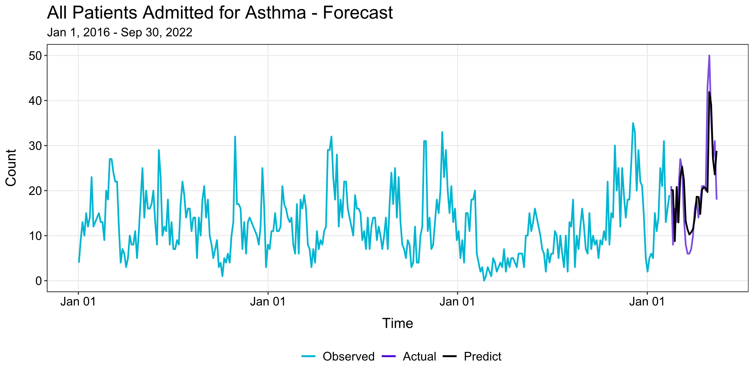
Example

Slide 36
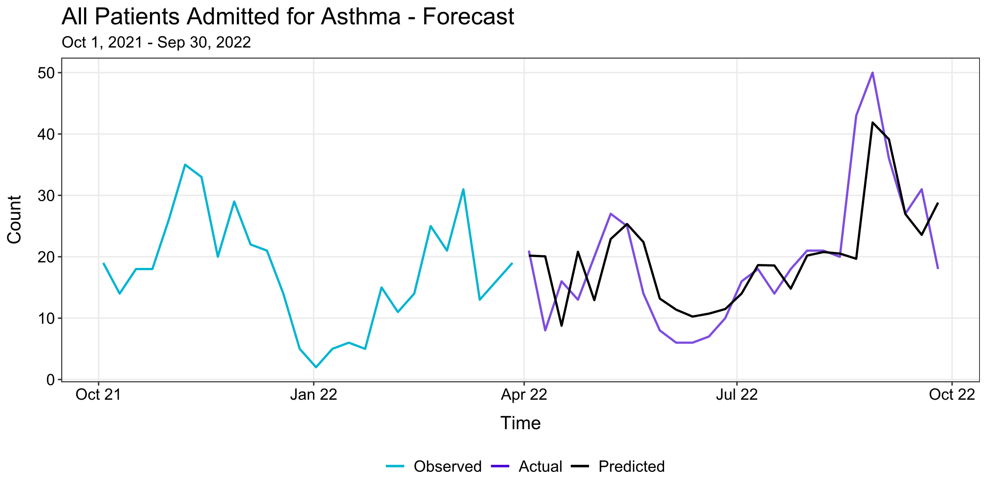
Example

Slide 37
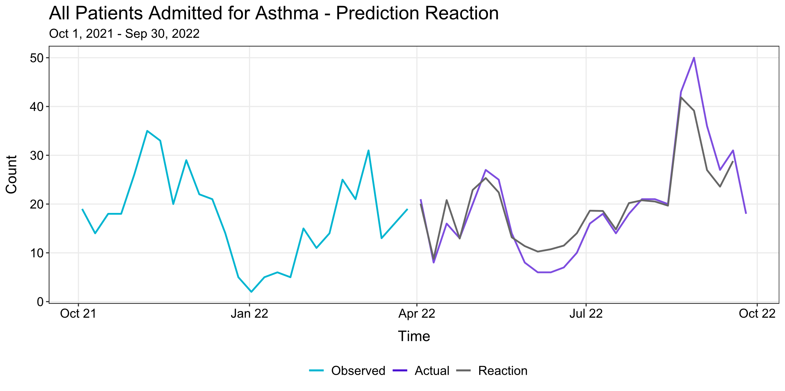
Example

Slide 38
Example
Evaluation (April 1 – September 30, 2022):
16/23 = 61.5% correctly predicted direction.
 | Predict | Actual
Increase | 12 | 12
Decrease | 13 | 11
Statistic | Value
Mean Error | -0.15
Mean Absolute Error | 5.10
Mean Squared Error (MSE) | 50.61
Median Error | -0.43
Median Absolute Error | 4.18
Median Absolute Percentage Error (MAPE) | 34.72%

Slide 39
Next Steps

Slide 40
Next Steps
We have a “proof-of-concept” of developing a prediction algorithm that forecasts weekly asthma admissions and how to evaluate model accuracy.
Apply for a pilot grant for further work.
Pilot Transitional and Clinical Studies.
Center for Clinical & Translational Science & Teaching (CCTST).
Write a grant that showcases the benefits for having our asthma prediction algorithm fully developed.
Future ideas can be formed into specific aims that could then be used for applying for a research grant.

Slide 41
Next Steps
Exploration of various time series models.
ARIMA, ETS, BATS, NN.
Dynamic models.
Use other predictors (e.g., AQI, weather, PM_{2.5}) to improve accuracy in model predictions.
How to estimate these predictors in the future to achieve predictions?
Evaluation of model prediction performance.
Determine prediction accuracy between models.
How prediction accuracy changes with time.
Accommodate holidays and periods with noticeable decline in asthma admissions.

Slide 42
Next Steps
Expanding the scope of asthma admissions.
Neighborhood level (e.g., Avondale, Clifton, City of Cincinnati).
R Shiny app for clinical use.
Server houses historical asthma data.
Clinician can explore predictions based on options they specify.
Report weekly asthma admissions trend.
How to interpret predictions from model adequately?
What is the message we should be sending to the clinician about our prediction algorithm tool?
42

Slide 43
Next Steps
Wider applications.
Modify ts_fit.R and ts_refit.R to areas outside of asthma admissions.
Employee injury data.
Publication of paper of our weekly asthma prediction algorithm.
Collection of the data.
Model (construction, evaluation).
Application of model.
General discussion.
43

Slide 44
Specific Aims
Expand the technical capabilities of the model.
Sub-populations based on neighborhood, parcel-level housing conditions, and enforced housing code violations.
Inclusion of “nowcasted” time-series data.
Temperature, humidity, AQI, pollen, mold.
Consideration of alternative computational model types.
Prophet.

Slide 45
Specific Aims
Implement 1-2 test-use cases of communicating forecasts.
Technical implementation of model within CCHMC clinical and research infrastructure.
Code repository for modeling and report creation.
Deployment on SALT.
Working with use case to design prediction and communication.
Will next week have higher/lower admissions?
When will admissions peak next quarter?

Slide 46
THANK YOU!

